Slide 1

5
INTEGRALS

Slide 2
INTEGRALS
In Chapter 2, we used the tangent
and velocity problems to introduce
the derivative—the central idea in differential calculus.

Slide 3
INTEGRALS
In much the same way, this chapter starts
with the area and distance problems and
uses them to formulate the idea of
a definite integral—the basic concept of integral calculus.

Slide 4
INTEGRALS
In Chapters 6 and 8, we will see how to use the integral to solve problems concerning:
  Volumes
  Lengths of curves
  Population predictions
  Cardiac output
  Forces on a dam
  Work
  Consumer surplus
  Baseball

Slide 5
INTEGRALS
There is a connection between integral calculus and differential calculus.
  The Fundamental Theorem of Calculus (FTC)
  relates the integral to the derivative.
  We will see in this chapter that it greatly simplifies
  the solution of many problems.

Slide 6
INTEGRALS
5.1
Areas and Distances
In this section, we will learn that:
We get the same special type of limit in trying to find
the area under a curve or a distance traveled.

Slide 7
AREA PROBLEM
We begin by attempting to solve
the area problem:
Find the area of the region S that lies
under the curve y = f(x) from a to b.

Slide 8
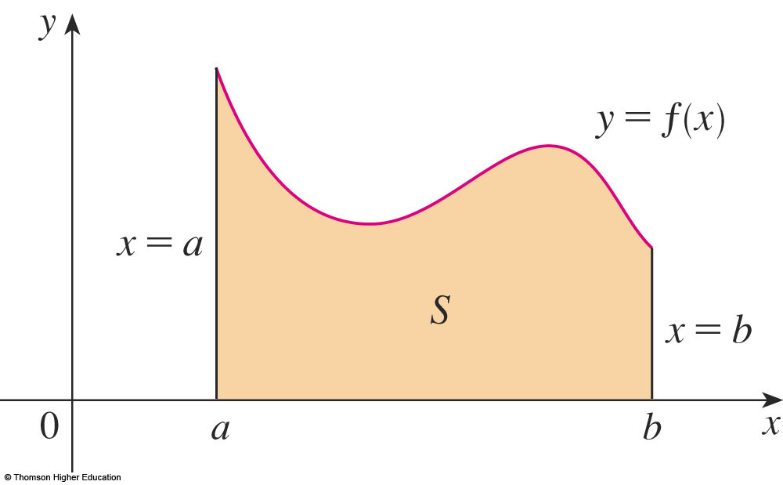
AREA PROBLEM
This means that S, illustrated here,
is bounded by:
  The graph of a continuous function f [where f(x) ≥ 0]
  The vertical lines x = a and x = b
  The x-axis

Slide 9
AREA PROBLEM
In trying to solve the area problem,
we have to ask ourselves:
  What is the meaning of the word area?

Slide 10
AREA PROBLEM
The question is easy to answer
for regions with straight sides.

Slide 11
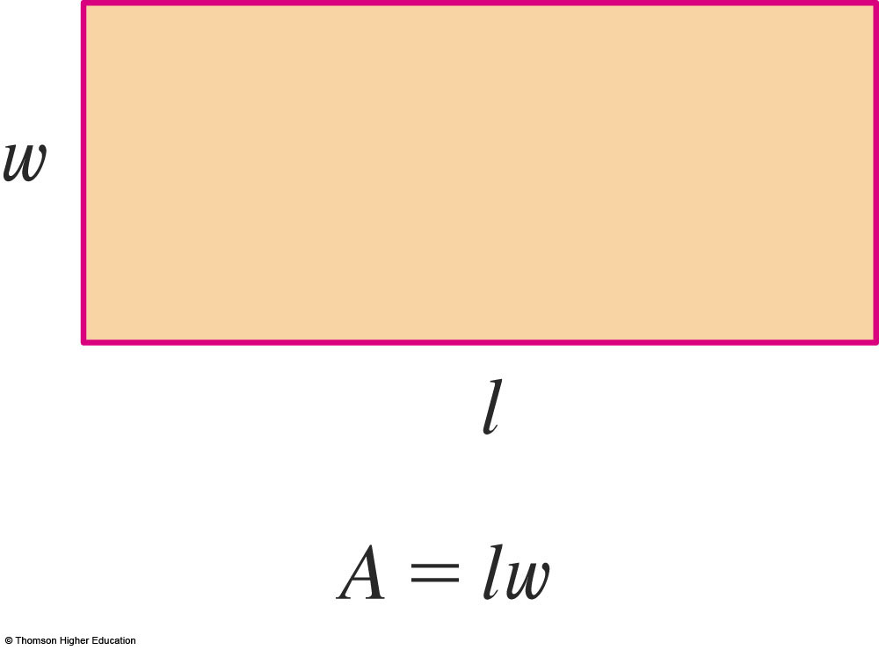
RECTANGLES
For a rectangle, the area is defined as:
  The product of the length and the width

Slide 12
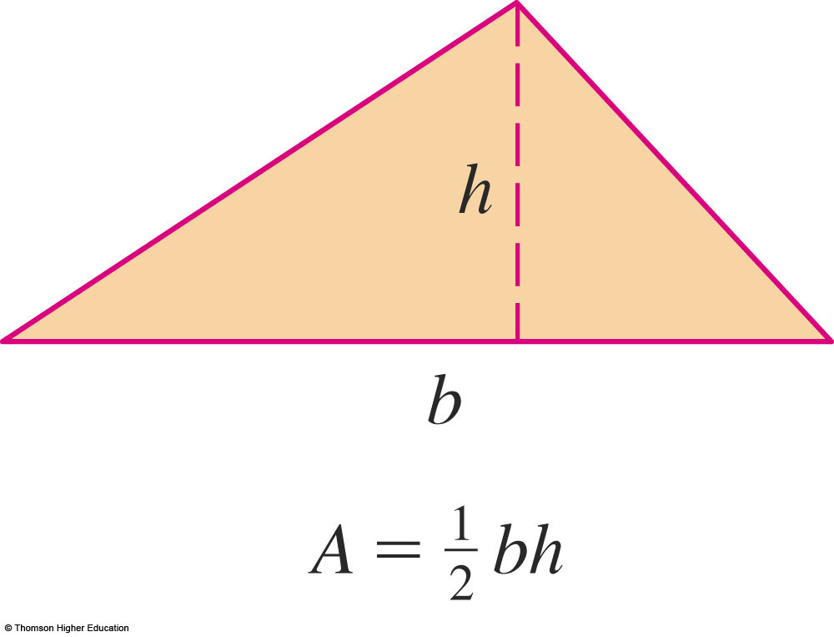
TRIANGLES
The area of a triangle is:
  Half the base times the height

Slide 13
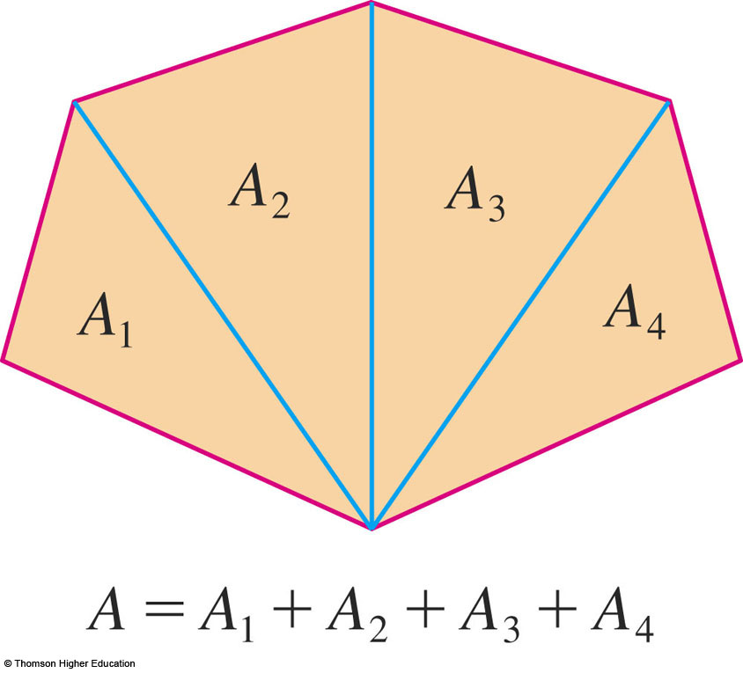
POLYGONS
The area of a polygon is found by:
  Dividing it into triangles and adding the areas
  of the triangles

Slide 14
AREA PROBLEM
However, it isn’t so easy to find the area
of a region with curved sides.
  We all have an intuitive idea of what the area
  of a region is.
  Part of the area problem, though, is to make this intuitive idea precise by giving an exact definition
  of area.

Slide 15
AREA PROBLEM
Recall that, in defining a tangent, we first approximated the slope of the tangent line
by slopes of secant lines and then we took
the limit of these approximations.
  We pursue a similar idea for areas.

Slide 16
AREA PROBLEM
We first approximate the region S by rectangles and then we take the limit of
the areas of these rectangles as we increase the number of rectangles.
  The following example illustrates the procedure.

Slide 17
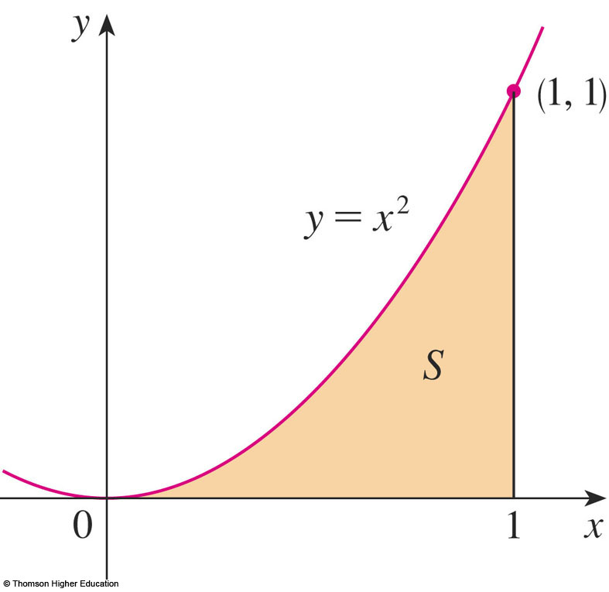
AREA PROBLEM
Example 1
Use rectangles to estimate the area under
the parabola y = x² from 0 to 1, the parabolic region S illustrated here.

Slide 18
AREA PROBLEM
Example 1
We first notice that the area of S must be somewhere between 0 and 1, because S
is contained in a square with side length 1.
  However, we can
  certainly do better
  than that.

Slide 19
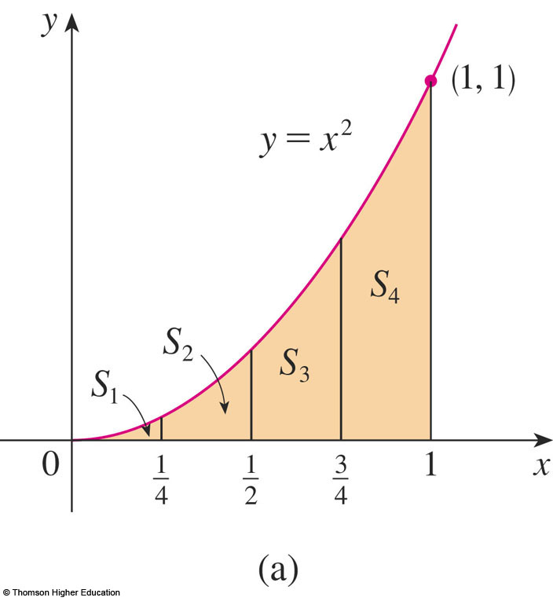
AREA PROBLEM
Example 1
Suppose we divide S into four strips
S₁, S₂, S₃, and S₄ by drawing the vertical lines x = ¼, x = ½, and x = ¾.

Slide 20
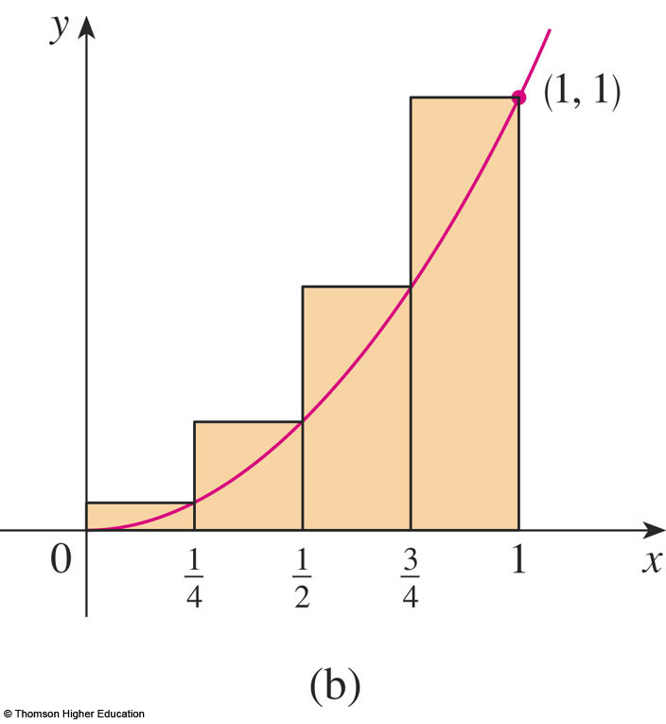
AREA PROBLEM
Example 1
We can approximate each strip by a rectangle whose base is the same as the strip and whose height is the same as the right edge
of the strip.

Slide 21
AREA PROBLEM
Example 1
In other words, the heights of these rectangles are the values of the function f(x) = x²
at the right endpoints of the subintervals
[0, ¼],[¼, ½], [½, ¾],
and [¾, 1].

Slide 22
AREA PROBLEM
Example 1
Each rectangle has width ¼ and
the heights are (¼)², (½)², (¾)², and 1².

Slide 23
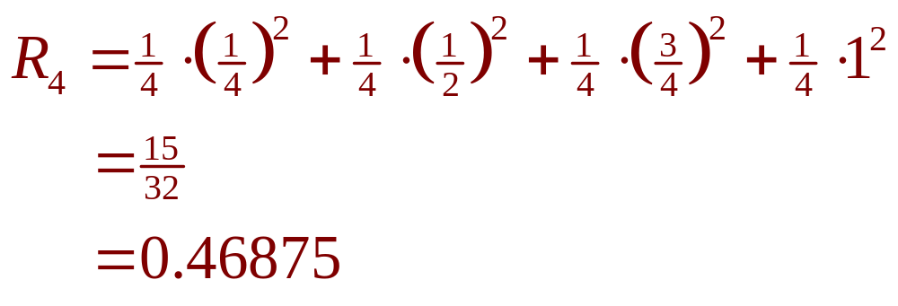
AREA PROBLEM
Example 1
If we let R₄ be the sum of the areas
of these approximating rectangles,
we get:

Slide 24
AREA PROBLEM
Example 1
We see the area A of S is less than R₄.
So, A < 0.46875

Slide 25
AREA PROBLEM
Example 1
Instead of using the rectangles in this figure, we could use the smaller rectangles in the next figure.

Slide 26
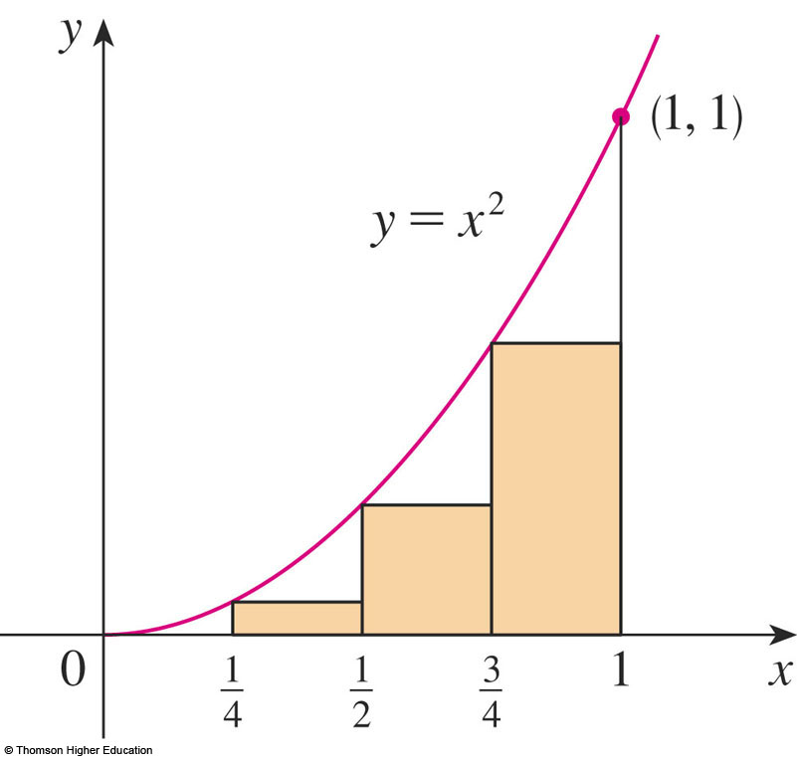
AREA PROBLEM
Example 1
Here, the heights are the values of f at
the left endpoints of the subintervals.
  The leftmost rectangle
  has collapsed because
  its height is 0.

Slide 27
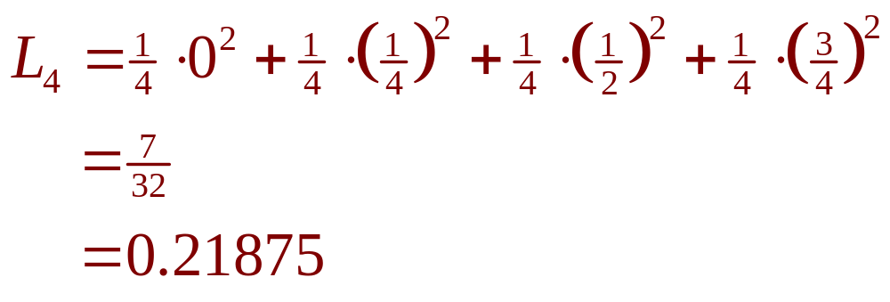
AREA PROBLEM
Example 1
The sum of the areas of these approximating rectangles is:

Slide 28
AREA PROBLEM
Example 1
We see the area of S is larger than L₄.
So, we have lower and
upper estimates for A:
0.21875 < A < 0.46875

Slide 29
AREA PROBLEM
Example 1
We can repeat this
procedure with a larger
number of strips.

Slide 30
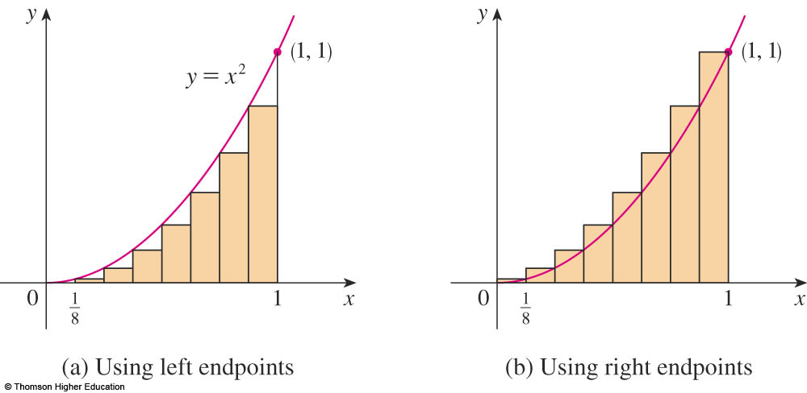
AREA PROBLEM
Example 1
The figure shows what happens when
we divide the region S into eight strips of equal width.

Slide 31
AREA PROBLEM
Example 1
By computing the sum of the areas of
the smaller rectangles (L₈) and the sum of
the areas of the larger rectangles (R₈),
we obtain better lower and upper estimates
for A:
0.2734375 < A < 0.3984375

Slide 32
AREA PROBLEM
Example 1
So, one possible answer to the question is to say that:
  The true area of S lies somewhere
  between 0.2734375 and 0.3984375

Slide 33
AREA PROBLEM
Example 1
We could obtain better
estimates by increasing
the number of strips.

Slide 34
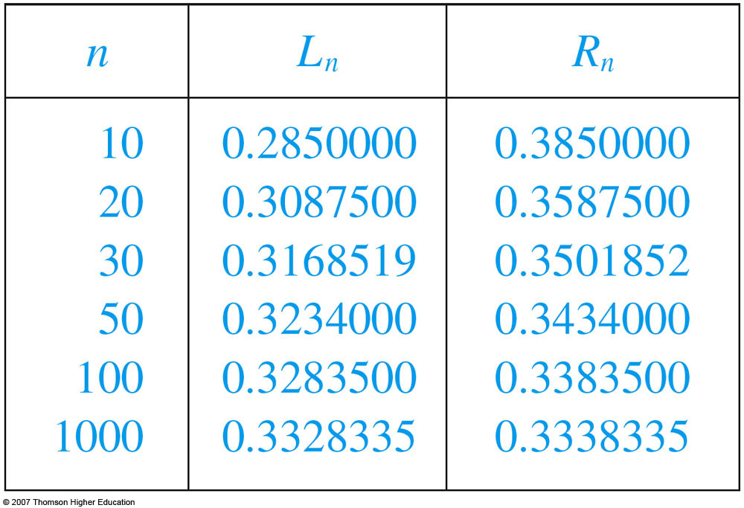
AREA PROBLEM
Example 1
The table shows the results of similar calculations (with a computer) using n rectangles, whose heights are found with
left endpoints (L_{n})
or right endpoints
(R_{n}).

Slide 35
AREA PROBLEM
Example 1
In particular, we see that by using:
  50 strips, the area lies between 0.3234 and 0.3434
  1000 strips, we narrow it down even more—A lies between 0.3328335 and 0.3338335

Slide 36
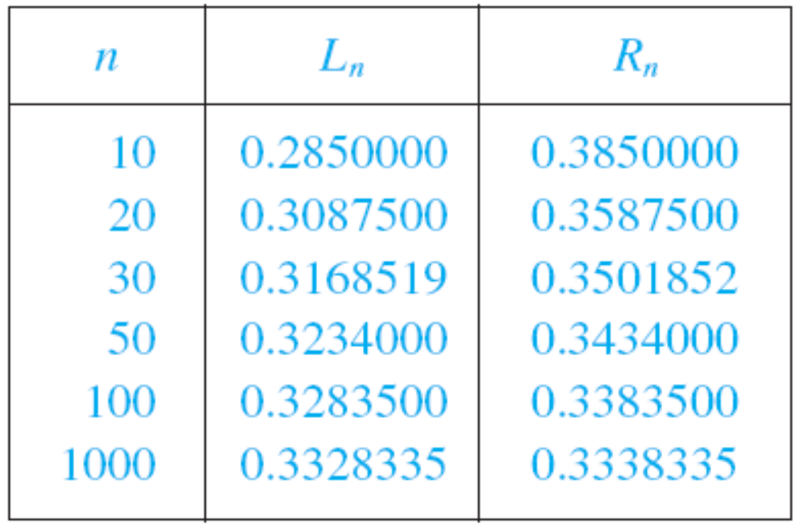
AREA PROBLEM
Example 1
A good estimate is obtained by averaging these numbers:
A ≈ 0.3333335

Slide 37
AREA PROBLEM
From the values in the table, it looks as if R_{n}
is approaching 1/3 as n increases.
  We confirm this in
  the next example.

Slide 38
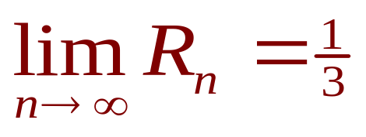
AREA PROBLEM
Example 2
For the region S in Example 1, show that
the sum of the areas of the upper approximating rectangles approaches 1/3,
that is,

Slide 39
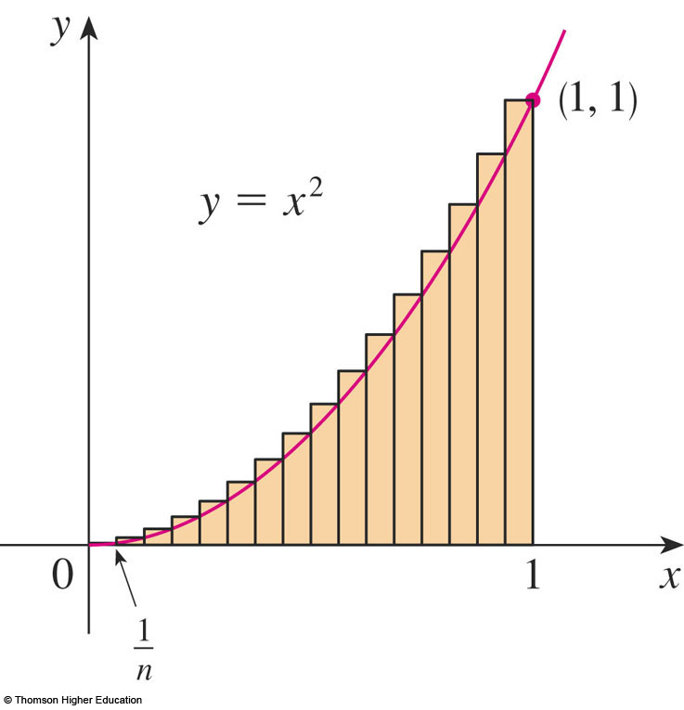
AREA PROBLEM
Example 2
R_{n} is the sum of the areas of the n rectangles.
  Each rectangle has width
  1/n and the heights are
  the values of the function
  f(x) = x² at the points
  1/n, 2/n, 3/n, …, n/n.
  That is, the heights are
  (1/n)², (2/n)², (3/n)², …,
  (n/n)².

Slide 40
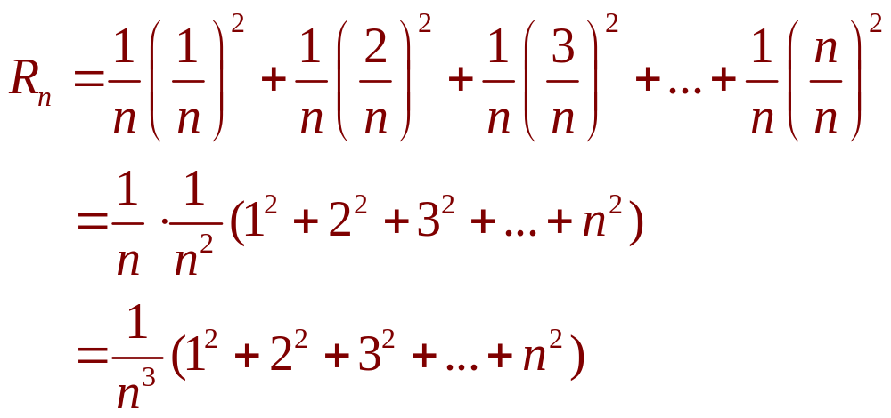
AREA PROBLEM
Example 2
Thus,

Slide 41
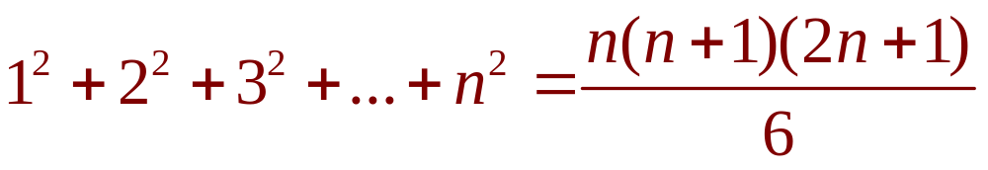
AREA PROBLEM
E. g. 2—Formula 1
Here, we need the formula for the sum of
the squares of the first n positive integers:
  Perhaps you have seen this formula before.
  It is proved in Example 5 in Appendix E.

Slide 42
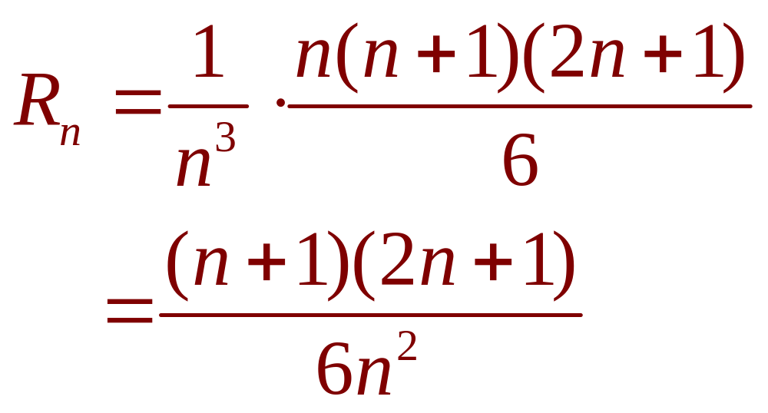
AREA PROBLEM
Example 2
Putting Formula 1 into our expression
for R_{n}, we get:

Slide 43
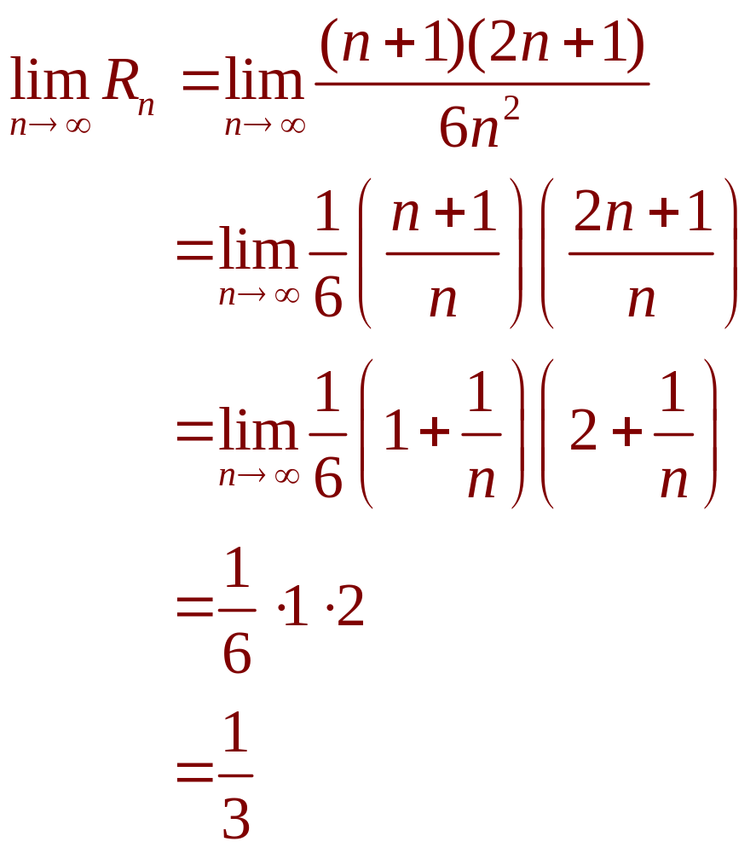
AREA PROBLEM
Example 2
So, we have:

Slide 44
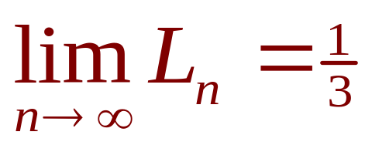
AREA PROBLEM
It can be shown that the lower approximating sums also approach 1/3, that is,

Slide 45
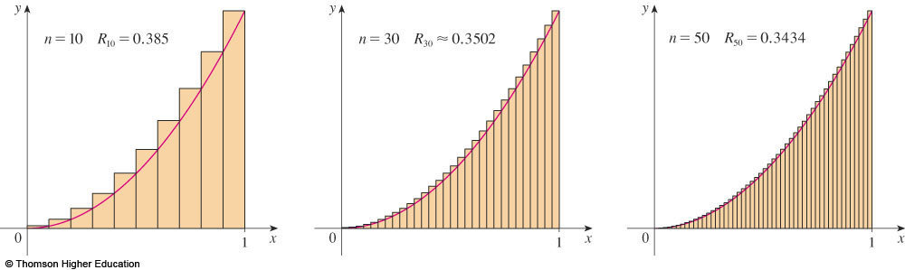
AREA PROBLEM
From this figure, it appears that, as n increases, R_{n} becomes a better and better approximation to the area of S.

Slide 46
AREA PROBLEM
From this figure too, it appears that, as n increases, L_{n} becomes a better and better approximations to the area of S.

Slide 47
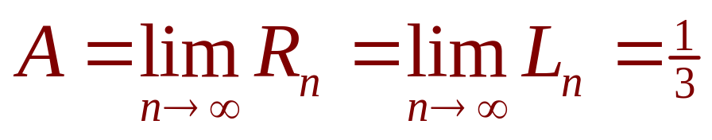
AREA PROBLEM
Thus, we define the area A to be the limit of the sums of the areas of the approximating rectangles, that is,

Slide 48
AREA PROBLEM
Let’s apply the idea of Examples 1 and 2
to the more general region S of the earlier figure.

Slide 49
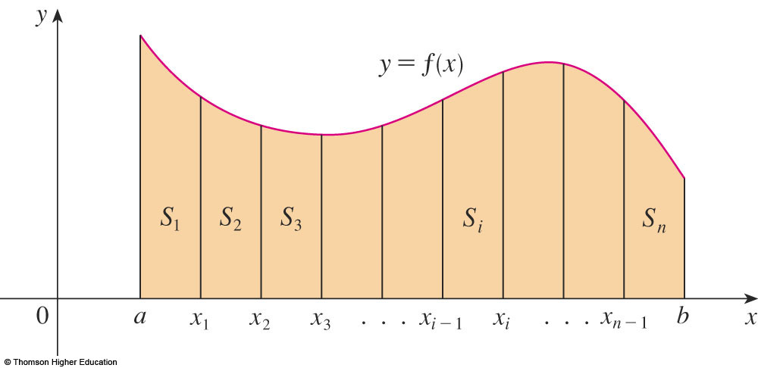
AREA PROBLEM
We start by subdividing S into n strips
S₁, S₂, …., S_{n} of equal width.

Slide 50
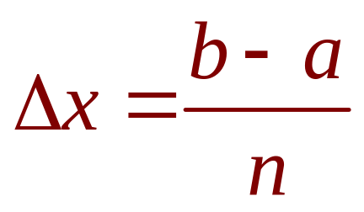
AREA PROBLEM
The width of the interval [a, b] is b – a.
So, the width of each of the n strips is:

Slide 51
AREA PROBLEM
These strips divide the interval [a, b] into n subintervals
[x₀, x₁], [x₁, x₂], [x₂, x₃], . . . , [x_{n-1}, x_{n}]
where x₀ = a and x_{n} = b.

Slide 52
AREA PROBLEM
The right endpoints of the subintervals are:
x₁ = a + ∆x,
x₂ = a + 2 ∆x,
x₃ = a + 3 ∆x,
.
.
.

Slide 53
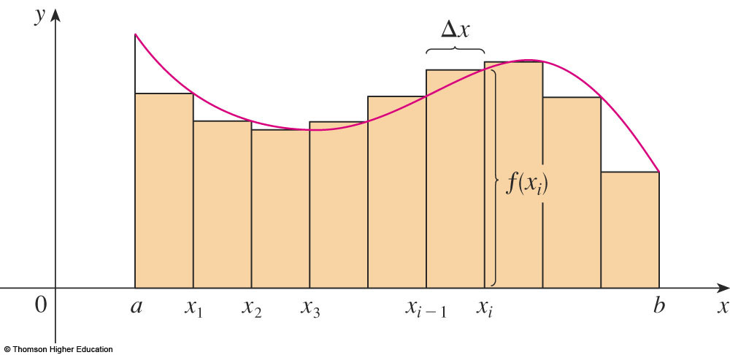
AREA PROBLEM
Let’s approximate the i ^{th} strip S_{i} by
a rectangle with width ∆x and height f(x_{i}), which is the value of f at the right endpoint.
  Then, the area of the i ^{th} rectangle is f(x_{i})∆x.

Slide 54
AREA PROBLEM
What we think of intuitively as the area of S
is approximated by the sum of the areas of these rectangles: R_{n} = f(x₁) ∆x + f(x₂) ∆x + … + f(x_{n}) ∆x

Slide 55
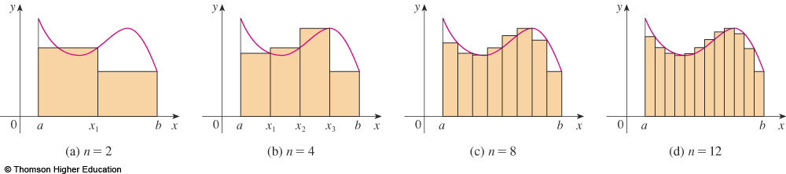
AREA PROBLEM
Here, we show this approximation for
n = 2, 4, 8, and 12.

Slide 56
AREA PROBLEM
Notice that this approximation appears to become better and better as the number of strips increases,
that is, as n → ∞.

Slide 57
AREA PROBLEM
Therefore, we define
the area A of the region S
as follows.

Slide 58
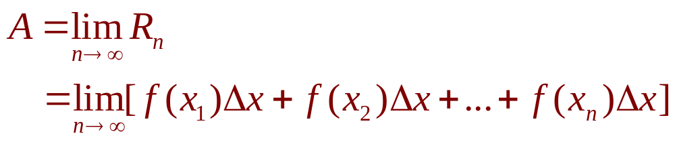
AREA PROBLEM
Definition 2
The area A of the region S that lies
under the graph of the continuous function f
is the limit of the sum of the areas of approximating rectangles:

Slide 59
AREA PROBLEM
It can be proved that the limit in
Definition 2 always exists—since
we are assuming that f is continuous.

Slide 60
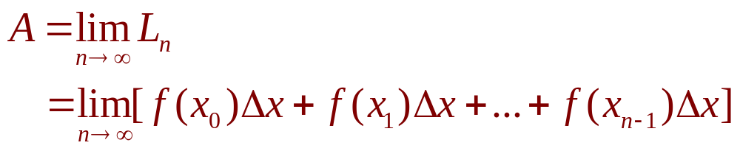
AREA PROBLEM
Equation 3
It can also be shown that we get the same value if we use left endpoints:

Slide 61
SAMPLE POINTS
In fact, instead of using left endpoints or right endpoints, we could take the height of the i ^{th} rectangle to be the value of f at any number x_{i}* in the i ^{th} subinterval [x_{i - 1}, x_{i}].
  We call the numbers x_{i}*, x₂*, . . ., x_{n}*
  the sample points.

Slide 62
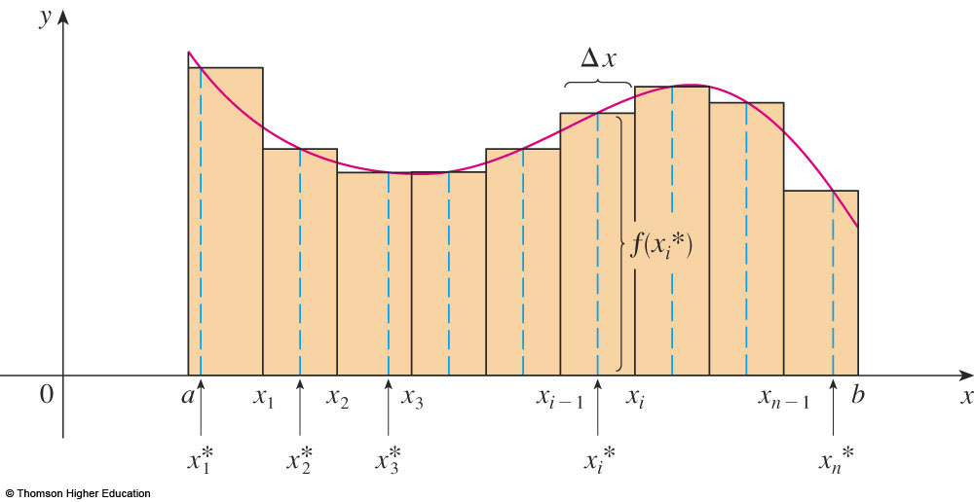
AREA PROBLEM
The figure shows approximating rectangles when the sample points are not chosen to be endpoints.

Slide 63
AREA PROBLEM
Equation 4
Thus, a more general expression for
the area of S is:

Slide 64
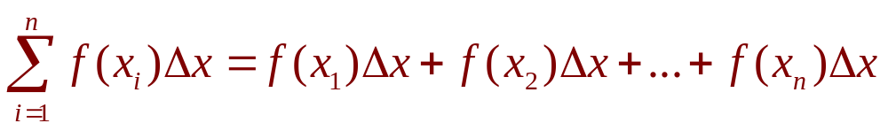
SIGMA NOTATION
We often use sigma notation to write sums with many terms more compactly.
For instance,

Slide 65
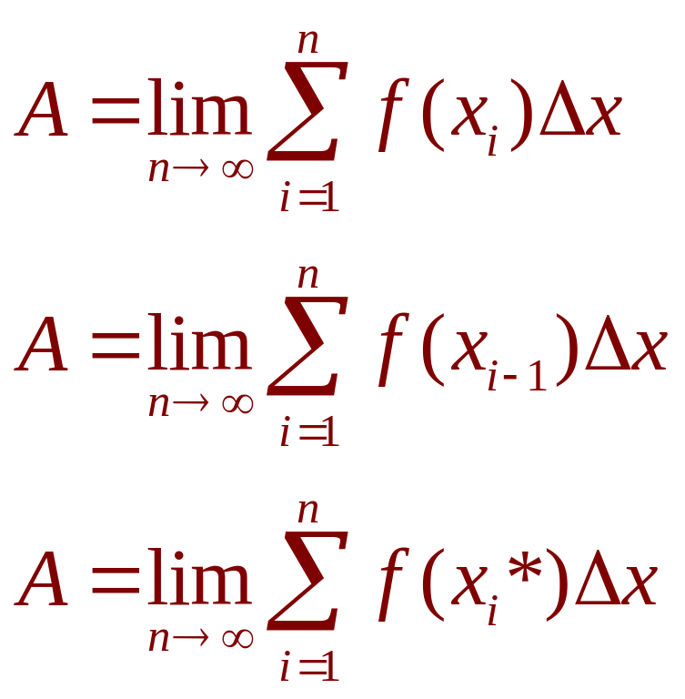
AREA PROBLEM
Hence, the expressions for area
in Equations 2, 3, and 4 can be written
as follows:

Slide 66
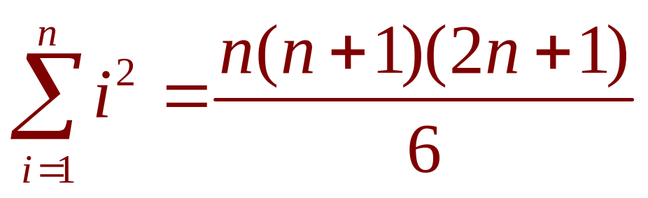
AREA PROBLEM
We can also rewrite Formula 1 in
the following way:

Slide 67
AREA PROBLEM
Example 3
Let A be the area of the region that lies under the graph of f(x) = e^{-x} between x = 0 and x = 2.
  Using right endpoints, find an expression for A
  as a limit. Do not evaluate the limit.
  Estimate the area by taking the sample points
  to be midpoints and using four subintervals
  and then ten subintervals.

Slide 68
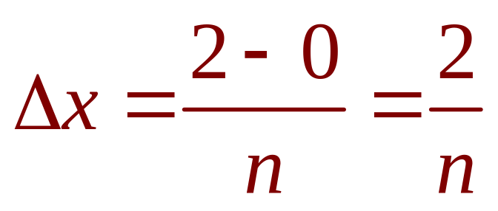
AREA PROBLEM
Example 3 a
Since a = 0 and b = 2, the width of
a subinterval is:
  So, x₁ = 2/n, x₂ = 4/n, x₃ = 6/n, x_{i} = 2i/n,
  x_{n} = 2n/n.

Slide 69
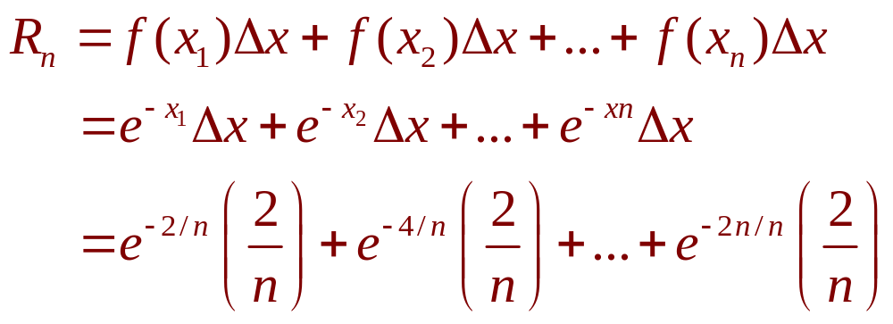
AREA PROBLEM
Example 3 a
The sum of the areas of the approximating rectangles is:

Slide 70
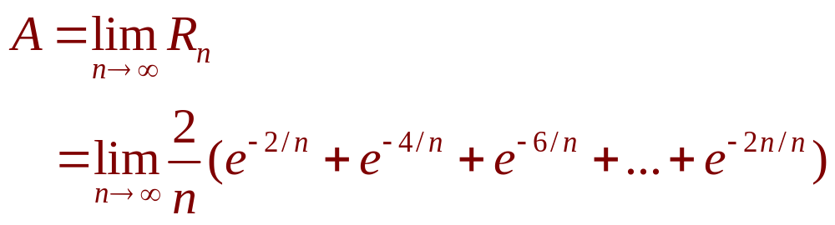
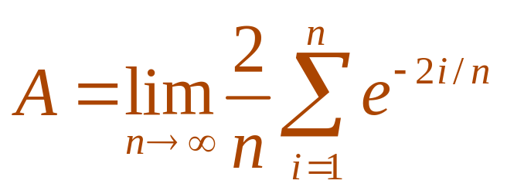
AREA PROBLEM
Example 3 a
According to Definition 2, the area is:
  Using sigma notation, we could write:

Slide 71
AREA PROBLEM
Example 3 a
It is difficult to evaluate this limit directly
by hand.
However, with the aid of a computer algebra system (CAS), it isn’t hard.
  In Section 5.3, we will be able to find A
  more easily using a different method.

Slide 72
AREA PROBLEM
Example 3 b
With n = 4, the subintervals of equal width ∆x = 0.5 are:
[0, 0.5], [0.5, 1], [1, 1.5], [1.5, 2]
The midpoints of these subintervals are:
x₁* = 0.25, x₂* = 0.75, x₃* = 1.25, x₄* = 1.75

Slide 73
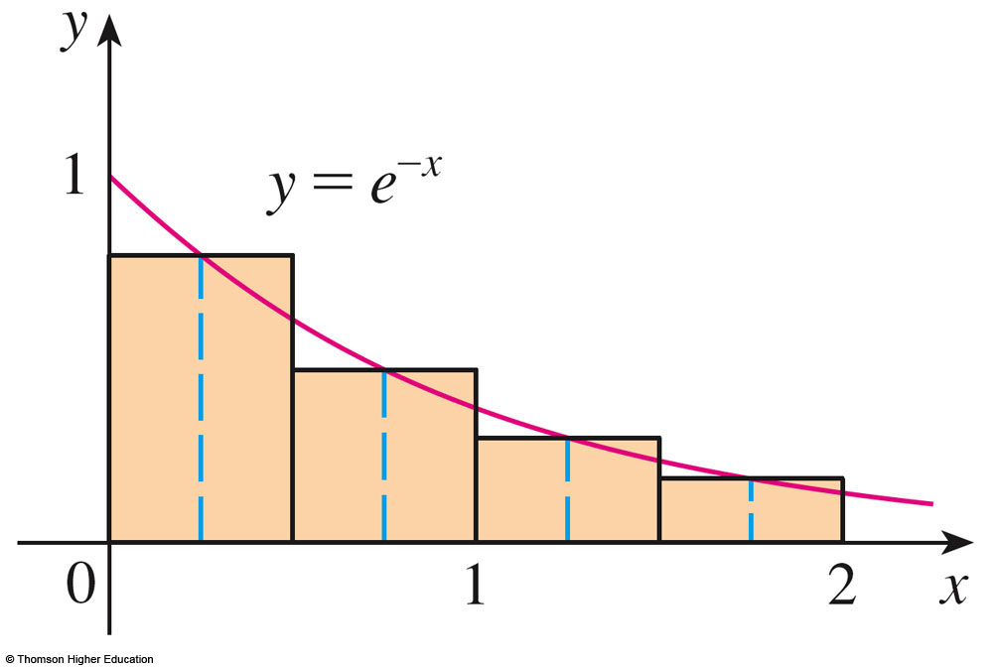
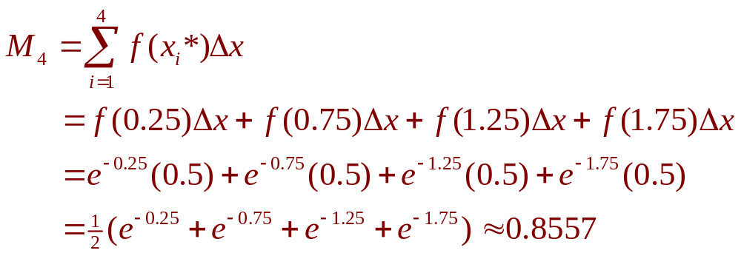
AREA PROBLEM
Example 3 b
The sum of the areas
of the four rectangles
is:

Slide 74
AREA PROBLEM
Example 3 b
With n = 10, the subintervals are:
[0, 0.2], [0.2, 0.4], . . . , [1.8, 2]
The midpoints are:
x₁* = 0.1, x₂* = 0.3, x₃* = 0.5, …, x₁₀* = 1.9

Slide 75
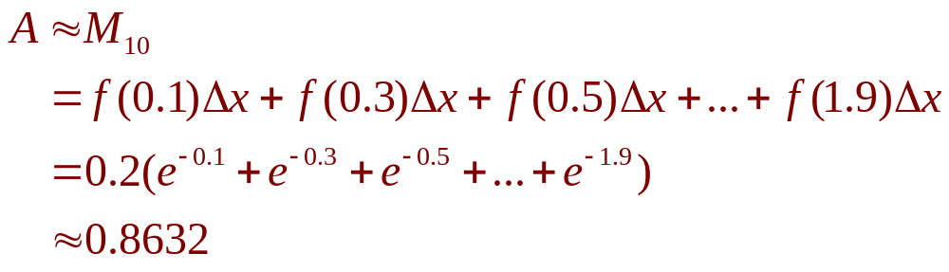
AREA PROBLEM
Example 3 b
Thus,

Slide 76
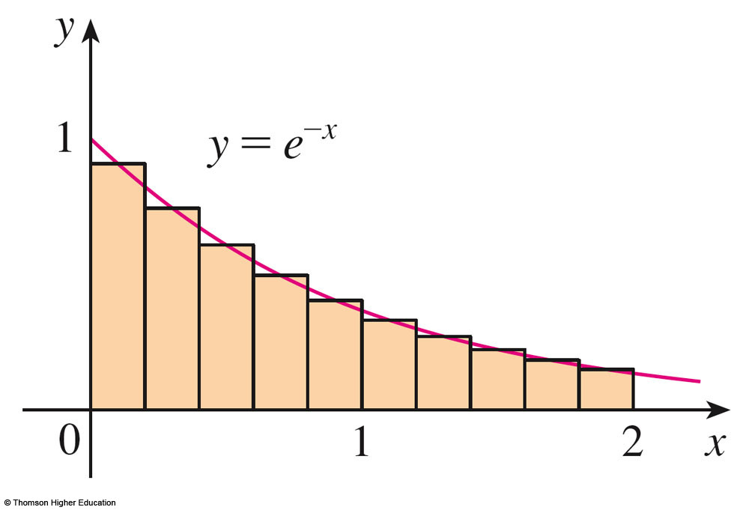
AREA PROBLEM
Example 3 b
From the figure, it appears that
this estimate is better than the estimate with n = 4.

Slide 77
DISTANCE PROBLEM
Now, let’s consider the distance problem:
Find the distance traveled by an object during a certain time period if the velocity of the object is known at all times.
  In a sense, this is the inverse problem of the velocity problem that we discussed in Section 2.1

Slide 78
CONSTANT VELOCITY
If the velocity remains constant, then
the distance problem is easy to solve
by means of the formula
distance = velocity x time

Slide 79
VARYING VELOCITY
However, if the velocity varies,
it’s not so easy to find the distance traveled.
  We investigate the problem in the following example.

Slide 80
DISTANCE PROBLEM
Example 4
Suppose the odometer on our car is broken and we want to estimate the distance driven over a 30-second time interval.

Slide 81
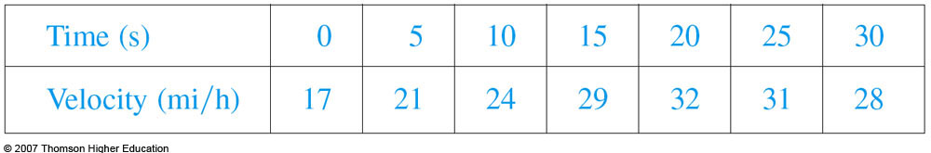
DISTANCE PROBLEM
Example 4
We take speedometer readings
every five seconds and record them
in this table.

Slide 82
DISTANCE PROBLEM
Example 4
In order to have the time and the velocity
in consistent units, let’s convert the velocity readings to feet per second
(1 mi/h = 5280/3600 ft/s)

Slide 83
DISTANCE PROBLEM
Example 4
During the first five seconds, the velocity doesn’t change very much.
  So, we can estimate the distance traveled during that time by assuming that the velocity is constant.

Slide 84
DISTANCE PROBLEM
Example 4
If we take the velocity during that time interval to be the initial velocity (25 ft/s), then we obtain the approximate distance traveled during the first five seconds:
25 ft/s x 5 s = 125 ft

Slide 85
DISTANCE PROBLEM
Example 4
Similarly, during the second time interval,
the velocity is approximately constant, and
we take it to be the velocity when t = 5 s.
  So, our estimate for the distance traveled
  from t = 5 s to t = 10 s is:
  31 ft/s x 5 s = 155 ft

Slide 86
DISTANCE PROBLEM
Example 4
If we add similar estimates for the other time intervals, we obtain an estimate for the total distance traveled:
(25 x 5) + (31 x 5) + (35 x 5)
+ (43 x 5) + (47 x 5) + (46 x 5)
= 1135 ft

Slide 87
DISTANCE PROBLEM
Example 4
We could just as well have used the velocity
at the end of each time period instead of
the velocity at the beginning as our assumed
constant velocity.
  Then, our estimate becomes:
  (31 x 5) + (35 x 5) + (43 x 5)
  + (47 x 5) + (46 x 5) + (41 x 5)
  = 1215 ft

Slide 88
DISTANCE PROBLEM
Example 4
If we had wanted a more accurate
estimate, we could have taken velocity readings every two seconds, or even
every second.

Slide 89
DISTANCE PROBLEM
Perhaps the calculations in Example 4 remind you of the sums we used earlier to estimate areas.

Slide 90
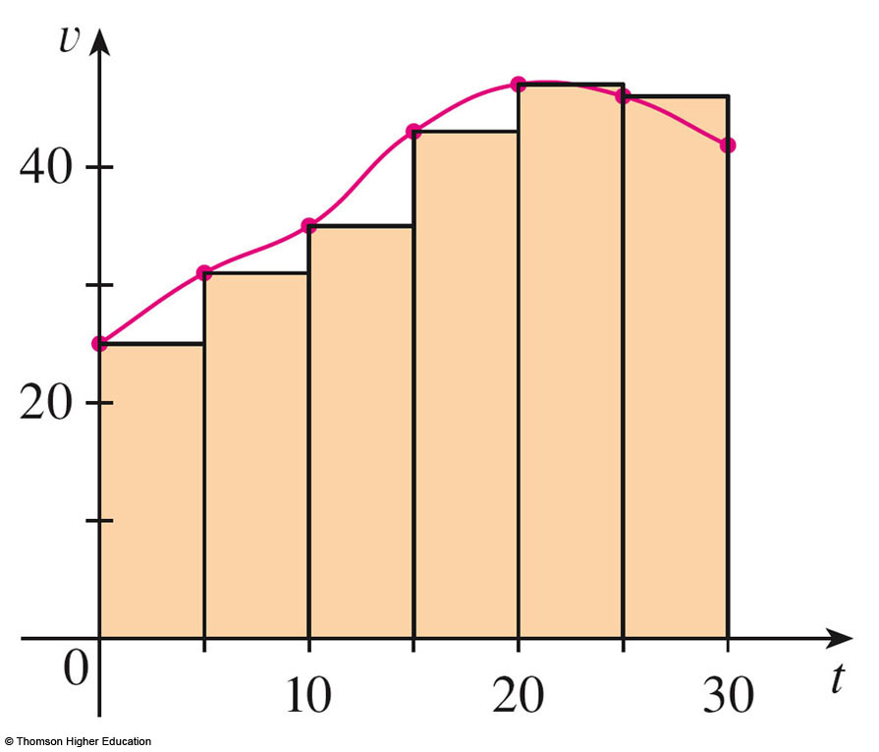
DISTANCE PROBLEM
The similarity is explained when we sketch
a graph of the velocity function of the car
and draw rectangles whose heights are
the initial velocities for
each time interval.

Slide 91
DISTANCE PROBLEM
The area of the first rectangle is 25 x 5 = 125, which is also our estimate for the distance traveled in the first five seconds.
  In fact, the area of each
  rectangle can be
  interpreted as a distance,
  because the height
  represents velocity and
  the width represents time.

Slide 92
DISTANCE PROBLEM
The sum of the areas of the rectangles is L₆ = 1135, which is our initial estimate for
the total distance traveled.

Slide 93
DISTANCE PROBLEM
In general, suppose an object moves
with velocity
v = f(t)
where a ≤ t ≤ b and f(t) ≥ 0.
  So, the object always moves in the positive direction.

Slide 94
DISTANCE PROBLEM
We take velocity readings at times
t₀(= a), t₁, t₂, …., t_{n}(= b)
so that the velocity is approximately constant on each subinterval.
  If these times are equally spaced, then
  the time between consecutive readings is:
  ∆t = (b – a)/n

Slide 95
DISTANCE PROBLEM
During the first time interval, the velocity
is approximately f(t₀).
Hence, the distance traveled is approximately f(t₀)∆t.

Slide 96
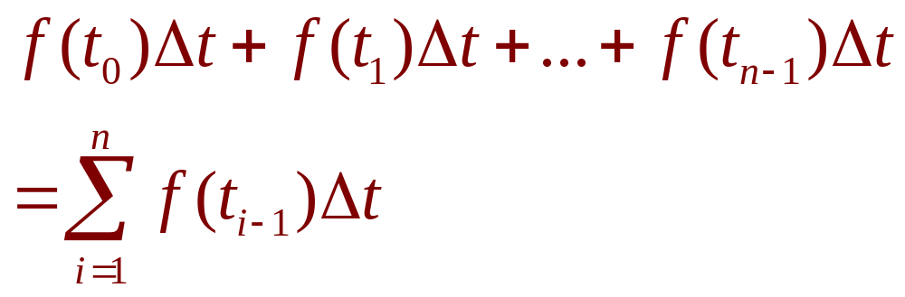
DISTANCE PROBLEM
Similarly, the distance traveled during
the second time interval is about f(t₁)∆t
and the total distance traveled during
the time interval [a, b] is approximately

Slide 97
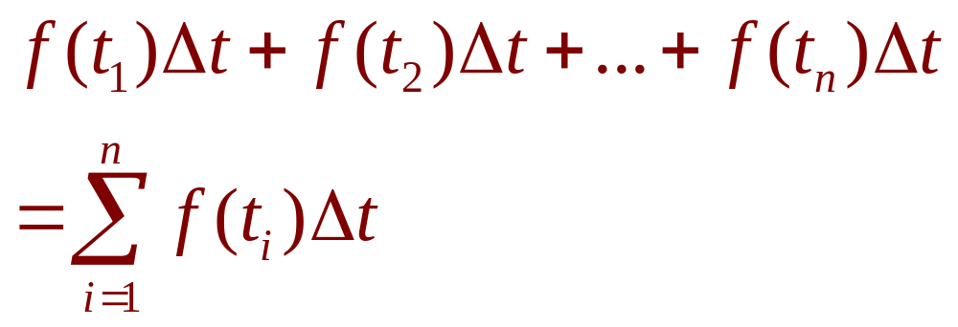
DISTANCE PROBLEM
If we use the velocity at right endpoints instead of left endpoints, our estimate for
the total distance becomes:

Slide 98
DISTANCE PROBLEM
The more frequently we measure
the velocity, the more accurate our estimates become.

Slide 99
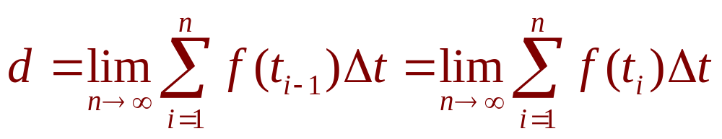
DISTANCE PROBLEM
Equation 5
So, it seems plausible that the exact distance d traveled is the limit of such expressions:
  We will see in Section 5.4 that this is indeed true.

Slide 100
SUMMARY
Equation 5 has the same form as our expressions for area in Equations 2 and 3.
So, it follows that the distance traveled
is equal to the area under the graph of
the velocity function.

Slide 101
SUMMARY
In Chapters 6 and 8, we will see that other quantities of interest in the natural and social sciences can also be interpreted as the area under a curve.
Examples include:
  Work done by a variable force
  Cardiac output of the heart

Slide 102
SUMMARY
So, when we compute areas in this chapter, bear in mind that they can
be interpreted in a variety of practical ways.

